Slide 1
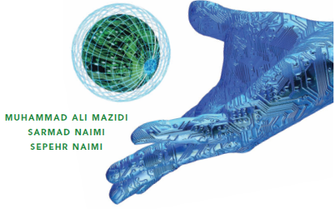
Introduction to Computing
Chapter 0
The AVR microcontroller
and embedded
systems
using assembly and c

Slide 2
Topics
Internal organization of computers
  The different parts of a computer
    I/O
    Memory
    CPU
  Connecting the different parts
    Connecting memory to CPU
    Connecting I/Os to CPU
  How computers work

Slide 3
Internal organization of computers
CPU
Memory
I/O
  Input
    E.g. Keyboard, Mouse, Sensor
  Output
    E.g. LCD, printer, hands of a robot

Slide 4
Memory
Everything that can store, retain, and recall information.
  E.g. hard disk, a piece of paper, etc.

Slide 5
Memory characteristics
Capacity
  The number of bits that a memory can store.
    E.g. 128 Kbits, 256 Mbits
Organization
  How the locations are organized
    E.g. a 128 x 4 memory has 128 locations, 4 bits each
Access time
  How long it takes to get data from memory
4 bits
0
1
2
128 locations
…
127

Slide 6
Internal parts of computers\CPU
Tasks:
  It should execute instructions
    It should recall the instructions one after another and execute them

Slide 7
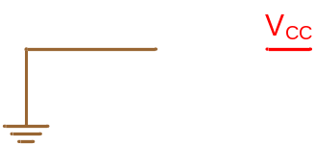
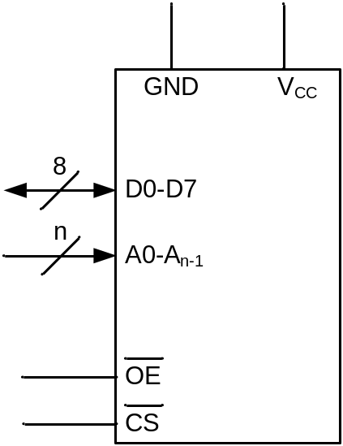

Connecting memory to CPU
Memory pin out

Slide 8
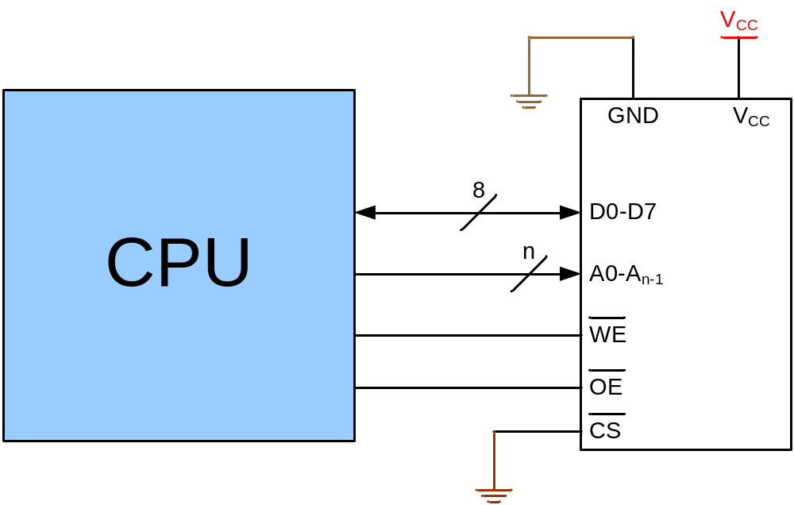
Connecting memory to CPU

Slide 9
Connecting I/Os to CPU
CPU should have lots of pins!
Mouse
CPU
Network
Keyboard
Sound Card
Graphic Card

Slide 10
Connecting I/Os to CPU using bus
CPU
Address bus
Data bus
Control bus
Write
Read
I/O 0
I/O 1
I/O 2
I/O n

Slide 11
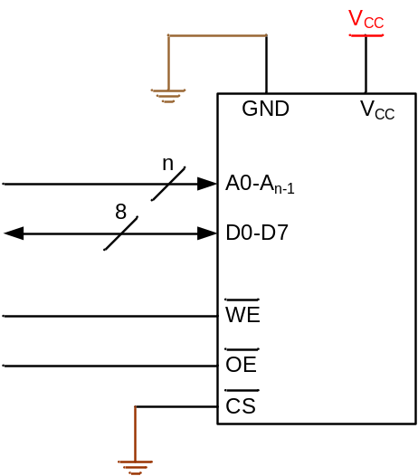
Connecting I/Os and Memory to CPU
CPU
Address bus
Data bus
Control bus
Write
Read
I/O 0
I/O 1
I/O 2
I/O n

Slide 12
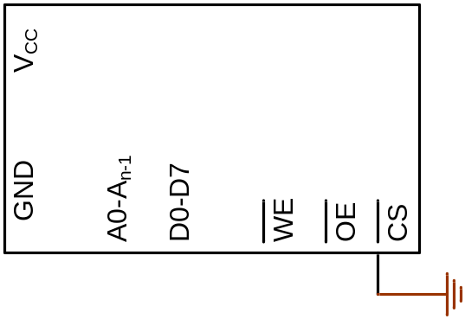
Connecting I/Os and memory to CPU using bus
0
1
2
3
How could we manage it?
CPU
0
Address bus
Data bus
Control bus
Write
Read
I/O 0
I/O 1
I/O 2
I/O n

Slide 13
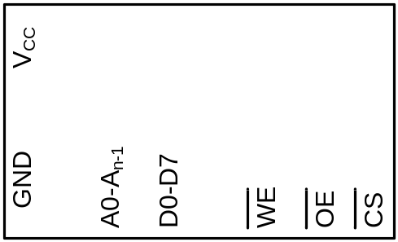
Connecting I/Os and Memory to CPU using bus
(Peripheral I/O)
0
1
..
63
CPU
Address bus
Data bus
Write
Control bus
Read
IO/MEM
I/O 0
I/O 1
I/O 2
I/O n

Slide 14
Connecting I/Os and Memory to CPU using bus
(Memory Mapped I/O)
The logic circuit enables CS when address is between
0 and15
0
1
..
15
CPU
Logic circuit
Address bus
Data bus
Control bus
Write
Read
I/O 16
I/O 17
I/O 18
I/O n

Slide 15
Inside the CPU
PC (Program Counter)
Instruction decoder
ALU (Arithmetic Logic Unit)
Registers
CPU
ALU
PC
A
B
C
Instruction decoder
D
registers

Slide 16
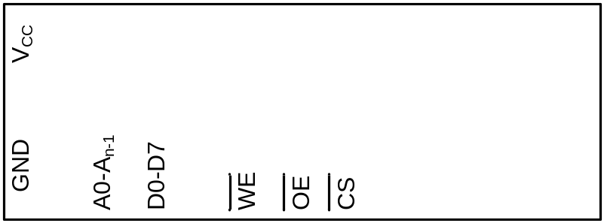
How computers work
A← [17]
B ← A
A ← [6]
A←A+B
[7]←A
31h
C4h
26h
81h
EAh
0h
5h
31
0
1
2
3
4
5
6
7
CPU
Address bus
Logic circuit
Data bus
Control bus
Write
Read
ALU
A
B
PC:
1
C
0
0
D
I/O 16
I/O 17
I/O 18
I/O n
Inst. Dec.
registers

Slide 17
How computers work
A← [17]
B ← A
A ← [6]
A←A+B
[7]←A
31h
C4h
26h
81h
EAh
0h
5h
0
1
2
3
4
5
6
7
CPU
Address bus
17
Logic circuit
Data bus
Control bus
Write
Read
ALU
A
B
PC:
1
C
9
D
I/O 16
I/O 17
I/O 18
I/O n
Inst. Dec.
registers
31

Slide 18
How computers work
A← [17]
B ← A
A ← [6]
A←A+B
[7]←A
31h
C4h
26h
81h
EAh
0h
5h
0
1
2
3
4
5
6
7
C4
26
5
CPU
17
Logic circuit
Address bus
6
Data bus
Control bus
Write
Read
9
ALU
9
A
B
PC:
1
2
2
1
C
3
D
I/O 16
I/O 17
I/O 18
I/O n
Inst. Dec.
registers

Slide 19
How computers work
A← [17]
B ← A
A ← [6]
A←A+B
[7]←A
31h
C4h
26h
81h
EAh
0h
5h
0
1
2
3
4
5
6
7
81
EA
CPU
Address bus
7
Logic circuit
Data bus
Eh
Control bus
Write
Read
E
5
ALU
5
+
A
E
9
9
B
PC:
4
4
3
C
3
5
D
I/O 16
I/O 17
I/O 18
I/O n
Inst. Dec.
registers

Slide 20
How Instruction decoder works
Opcode
Operand
Opcode
Operand
Instruction
Instruction
Operation Code | Meaning
000 | A ← x
001 | A ← [x]
010 | A ← A – register (x)
011 | A ← A + x
100 | A ← A + register (x)
101 | A ← A – x
110 | Register (x_{H}) ← Register (x_{L})
111 | [x] ← A
0011 0001
1100 0100
0010 0110
1000 0001
1110 1010
0000 0000
0000 0101
31h
C4h
26h
81h
EAh
0h
5h
A← [17]
B ← A
A ← [6]
A←A+B
[7]←A
0
1
2
3
4
5
6
7

Slide 21
Memory contains code and data
What happens when you remove power?
A← [17]
B ← A
A ← [6]
A←A+B
[7]←A
31h
C4h
26h
81h
EAh
0h
5h
0
1
2
3
4
5
6
7

Slide 22
Two memory chips – RAM & ROM
Code
Memory
(ROM)
Data
Memory
(RAM)
CPU
Data bus
Address bus
Control bus

Slide 23
Two memory chips – No change to program
A← [17]
B ← A
A ← [6]
A←A+B
[7]←A
0
1
2
3
4
5
0h
5h
31h
C4h
26h
81h
EAh
0h
6
7
8
9
A
B
C
D
Code
Memory
Data
Memory
CPU
Data bus
Address bus
Control bus
I/O 16
I/O 17

Slide 24
Two memory chips – RAM & ROM
Code
Memory
(ROM)
Data
Memory
(RAM)
CPU
Data bus
Address bus
Control bus

Slide 25
Two memory chips – RAM & ROM
Chip select activates on
addresses 0 -> 5
Code
Memory
(ROM)
Data
Memory
(RAM)
Chip select activates on
addresses 6 ->15
CPU
Data bus
Address bus
Control bus
I/O 16
I/O 17
What happens when power is removed now?

Slide 26
Von Neumann architecture
Code
Memory
(ROM)
Data
Memory
(RAM)
CPU
Data bus
Address bus
Control bus
I/O 16
I/O 17
Von Neumann bottleneck

Slide 27
Harvard architecture
CPU
Code
Memory
(ROM)
Data bus
Data bus
Data
Memory
(RAM)
Address bus
Address bus
Control bus
Control bus
I/O 16
I/O 17
Can fetch next instruction while executing previous one
Simple pipelining
Used in most small micros including the ATmega328p

